Slide 1
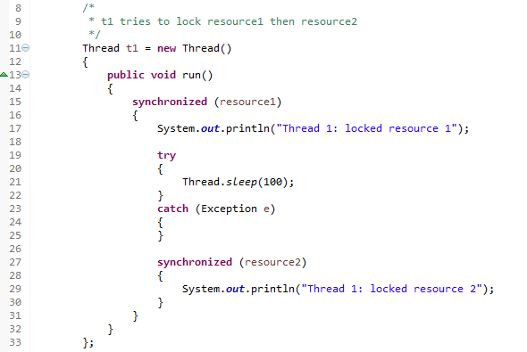
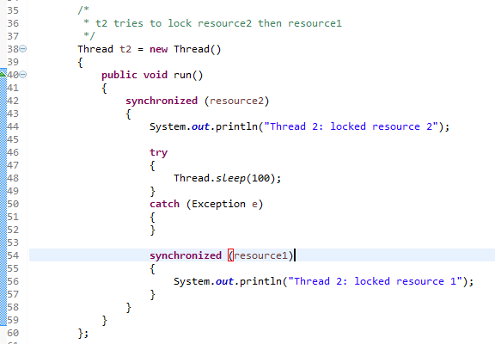
Deadlock in java
Deadlock in java is a part of multithreading. Deadlock can occur in a situation when a First thread is waiting for an object lock, that is acquired by second thread and second thread is waiting for an object lock that is acquired by first thread. Since, both threads are waiting for each other to release the lock, the condition is called deadlock.
T1
T2
resourse1
Locked by T1
resourse2
Locked by T2
1.T1 locks resources1
and sleeps for 100ms
2.T2 locks resources2
and sleeps for 100ms
3.T1 tries to lock resource2
and but it is already locked by T2,So T1
Keeps on waiting in 27th line to get the lock
of resource2.
4.T2 tries to lock resource1
and but it is already locked by T1,
So T2 keep on waiting in 54th line to
get the lock of resources1

